Slide 1
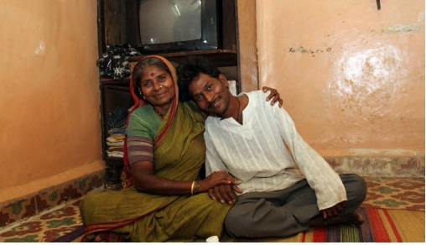


The role of DTG based regimens in first- and second-line HIV treatment and PEP – Updated WHO recommendations
Meg Doherty MD MPH PhD
23 July 2018
WHO HQ
Notes:
All-Russian Festival of colors in the park "Kyrlay“ – 2017 music festival

Slide 2
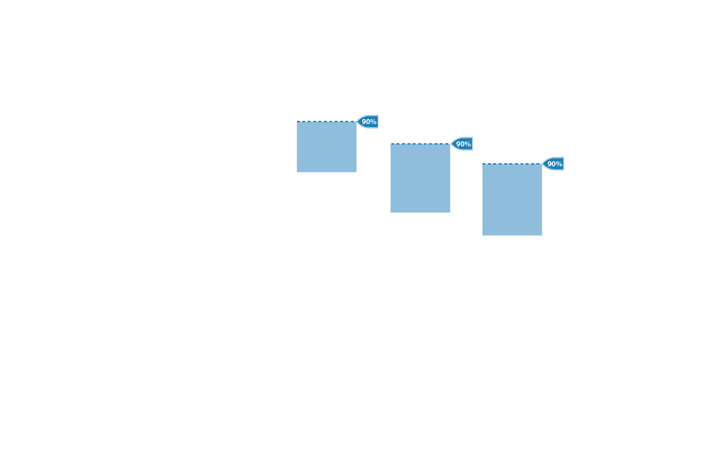
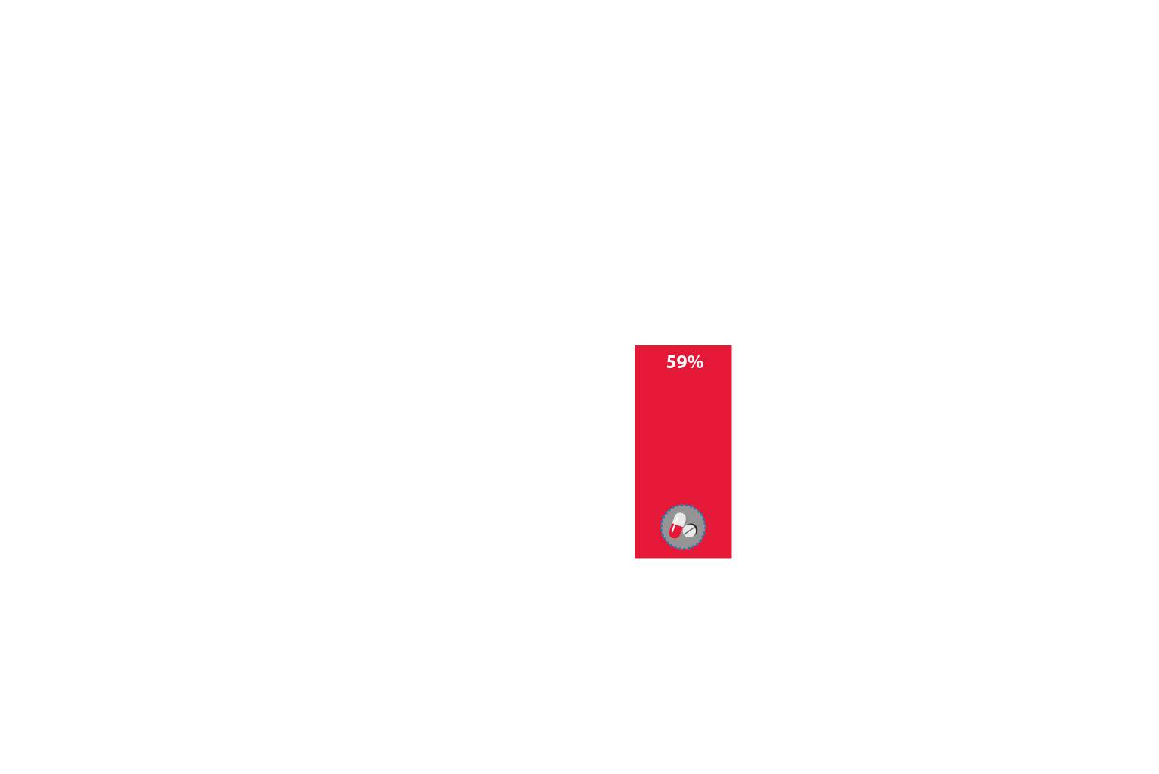
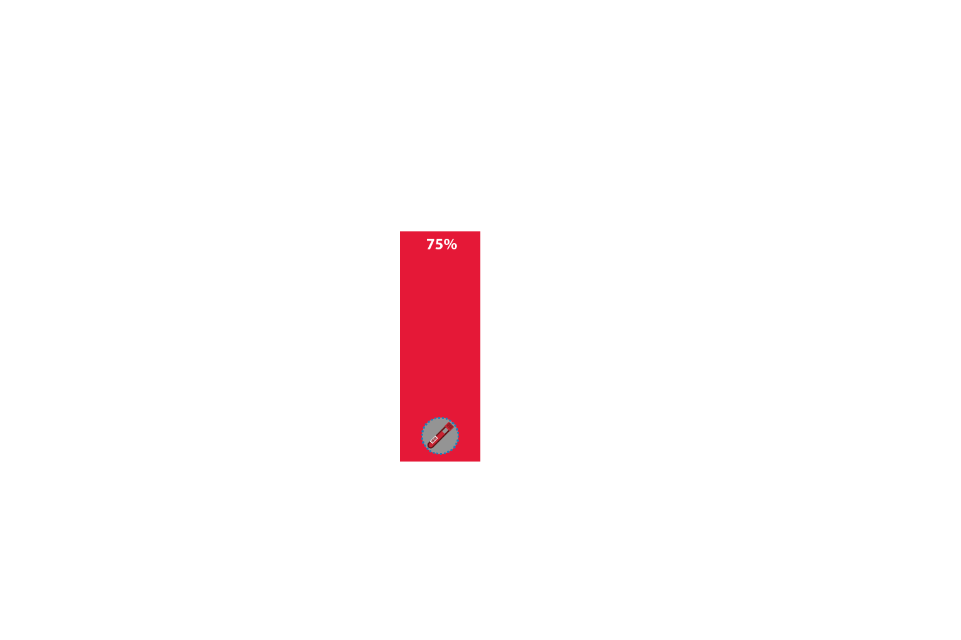
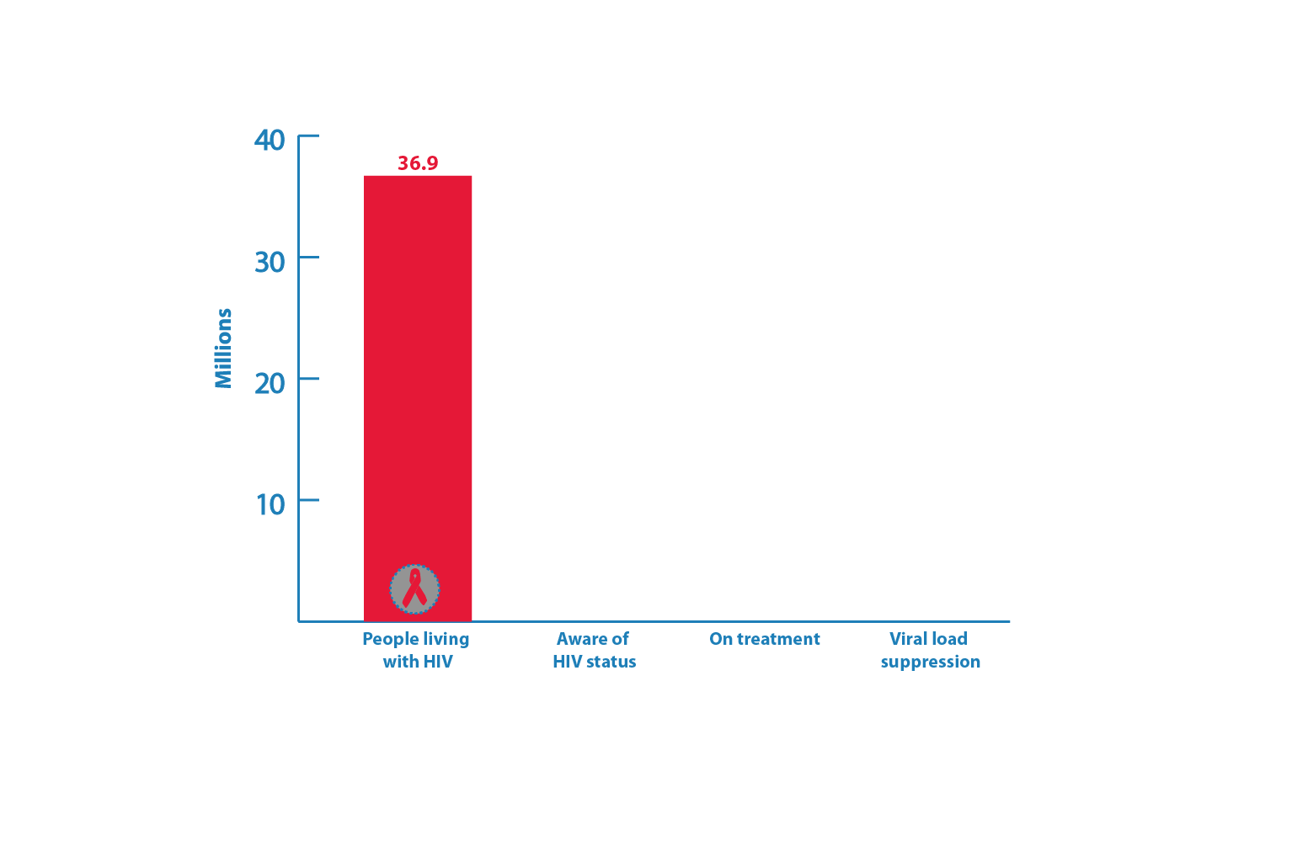

HIV testing and care continuum (2017)
Source: UNAIDS/WHO estimates

Slide 3
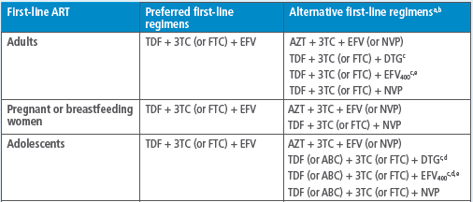
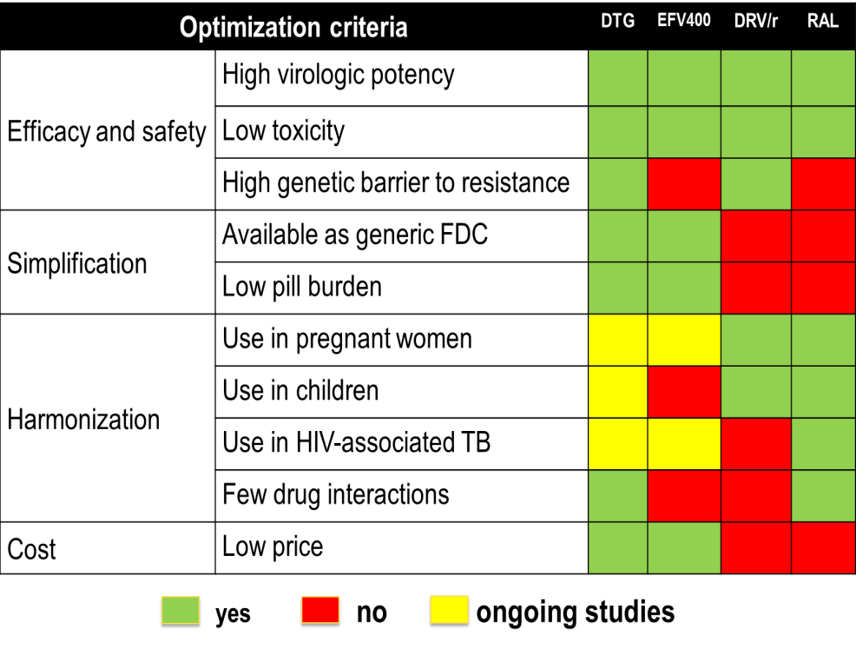
2016 WHO recommandations for 1st Line ART in Adults and Adolescents
In 2017 WHO Recommendations:
1) Countries with national pretreatment HIVDR to EFV or NVP ≥10% should consider a RAPID transition to non-NNRTI for all new ART starters:
2) ART starters with reported prior exposure to ARVs: start a non-NNRTI (i.e. DTG), regardless of level of PDR
WHO Consolidated ARV Guidelines , 2016

Slide 4

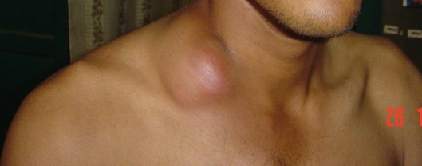
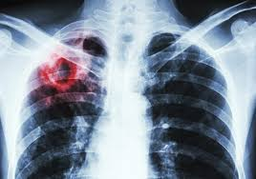
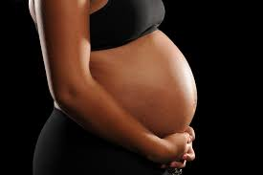
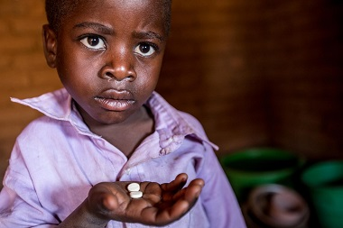
Gaps on clinical use of dolutegravir
CNS side effects: higher than expected rate of DTG discontinuation due insomnia in some cohort studies (higher rates compared with RCTs) but very low occurrence of other side effects.
IRIS in PLHIV with advanced HIV disease: increased risk observed in some cohort studies but not detected in RCTs with other INSTIs (REALITY trial).
HIV-associated TB: need to double dose if rifampin is used (INSPIRING – 50 mg BID)
Pregnant/BF women: limited safety data, very high DTG concentrations in blood cord at birth (clinical studies ongoing)
Infants and children: safety and dose finding trial underway.
Very limited clinical experience

Slide 5
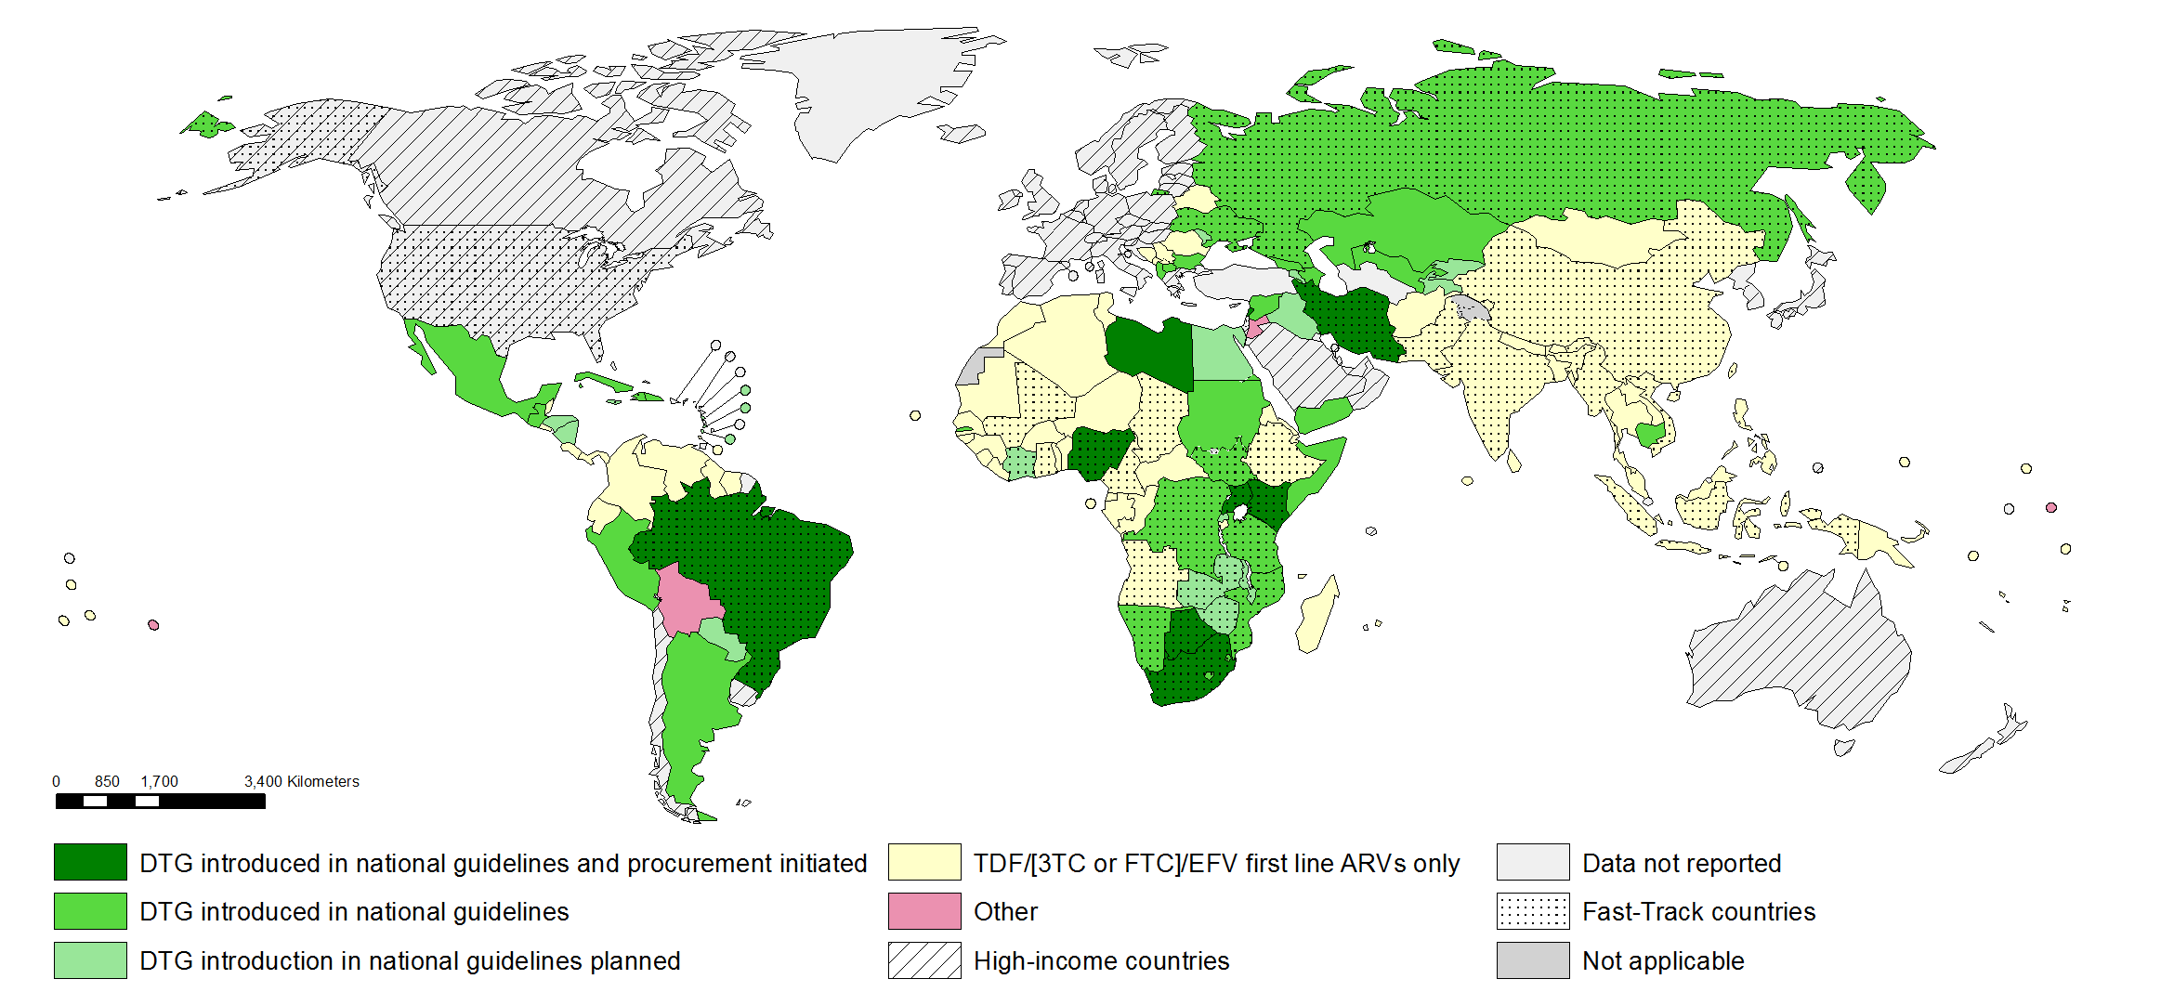
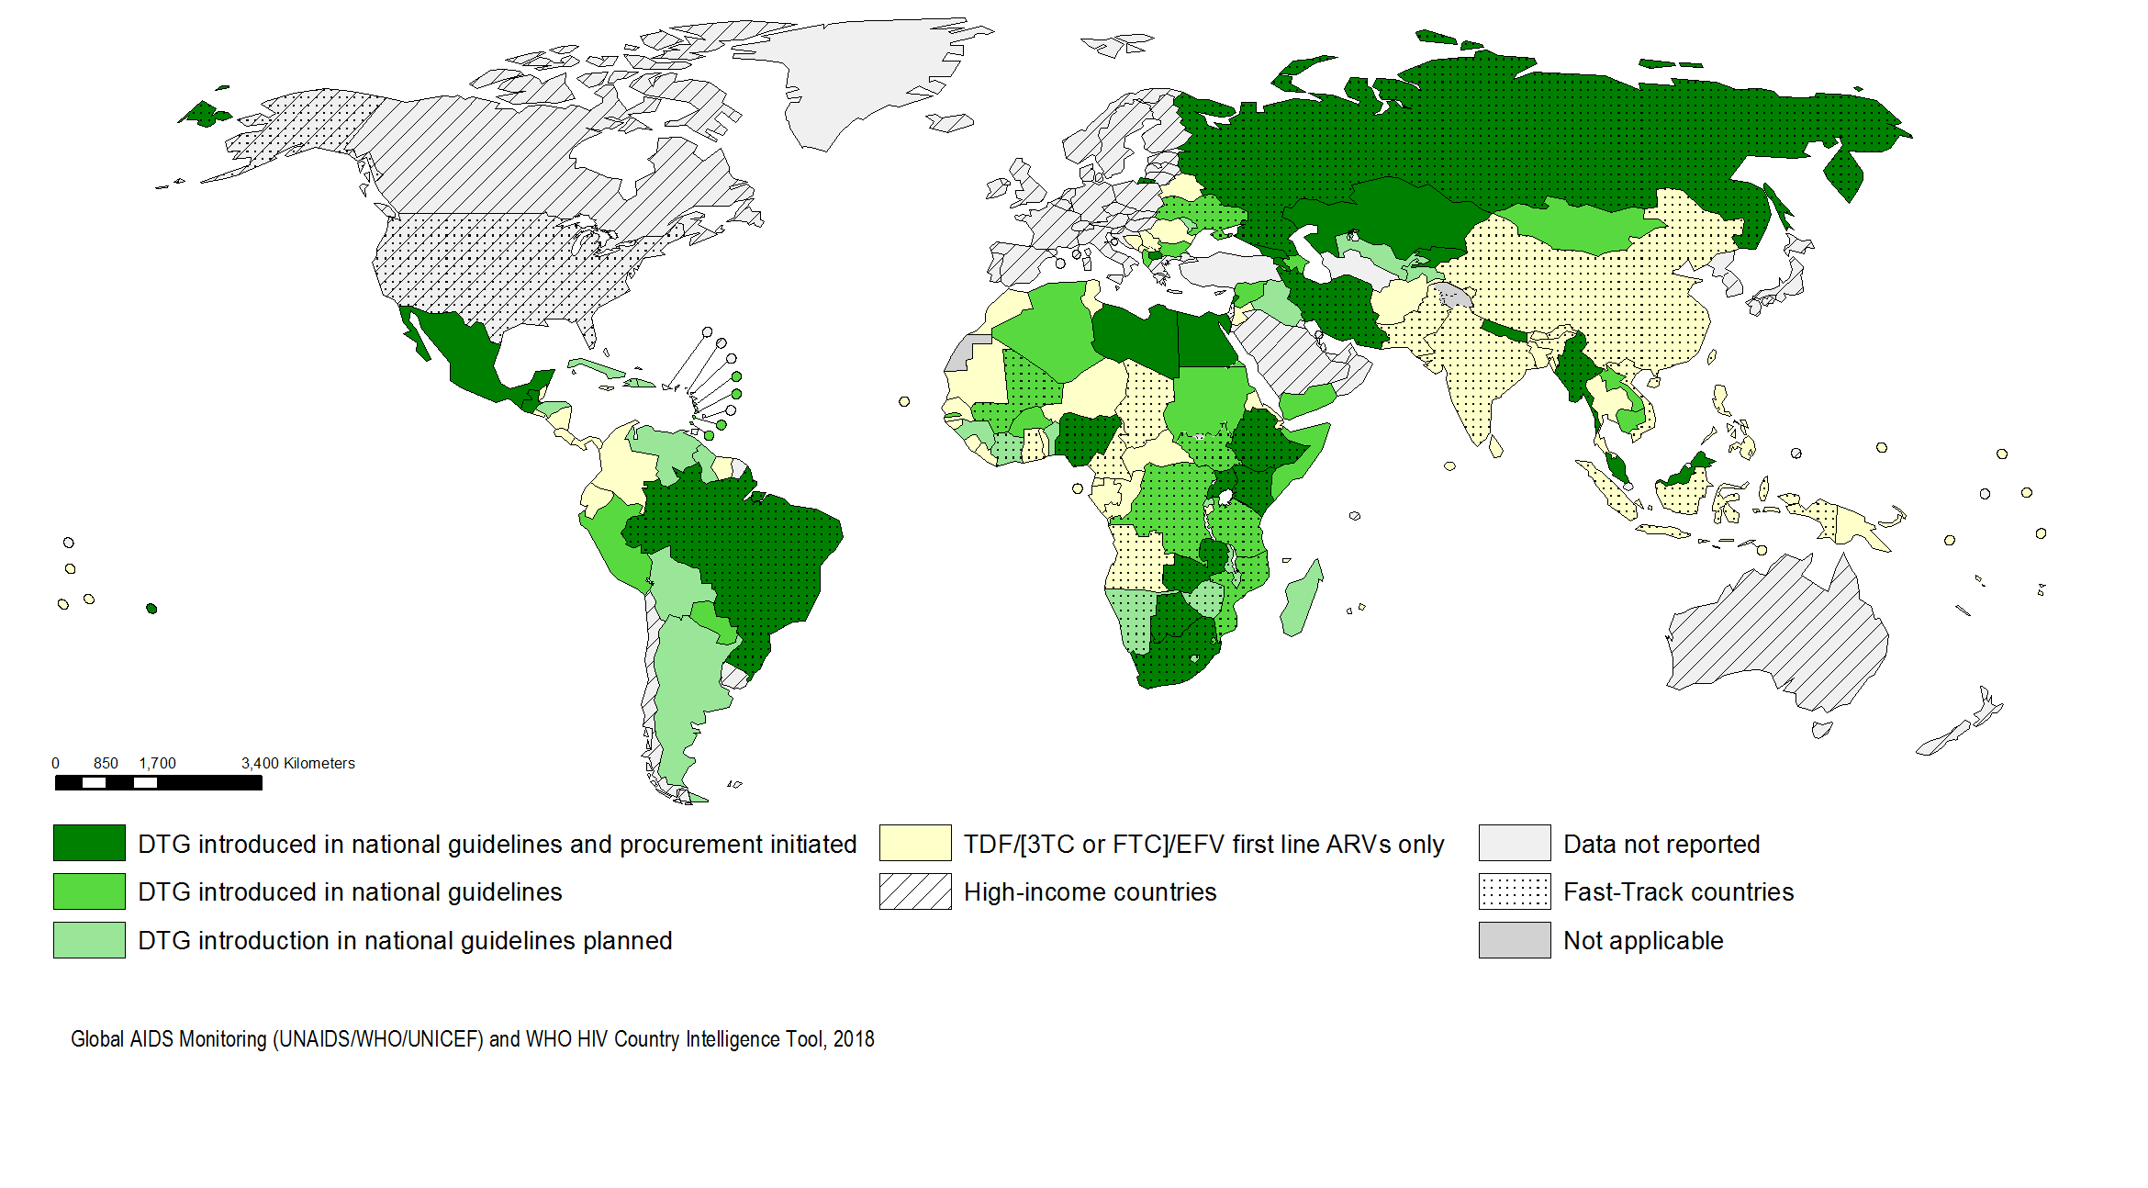
Progress in transition to Dolutegravir (DTG) as a preferred first line ARV regimen in LMIC
(progress from November 2017 to July 2018)
98 (51%) of LMIC are making shifts to DTG containing regimens
Notes:
87 countries (45%) of LMIC adopted TDF/[3TC or FTC]/EFV as the preferred first-line therapy, whereas an additional 98 (51%) of LMIC are making shifts to DTG containing regimens (measured as composite indicator of countries that have introduced or are introducing DTG in their guidelines and procurement of DTG has been initiated).
# LMIC JULY 2018
Data not reported 5
DTG introduced in national guidelines 26 DTG introduced in national guidelines and procurement initiated 24
DTG introduction in national guidelines planned 21
TDF/[3TC or FTC]/EFV first line ARVs only 63
Grand Total 139
In November 2017: 72% of LMIC adopted TDF/3TC or FTC)/EFV as the preferred first-line therapy, whereas an additional 40% of LMIC are making shifts to DTG containing regimens.

Slide 6
New findings informed DTG safety profile among women of child bearing potential
NIH‐funded study identified a potential safety concern and reported it to the World Health Organization (WHO) and ViiV Healthcare.
Observational study in Botswana, found 4 cases of neural tube defects out of 426 women who became pregnant while taking DTG.
This rate of approximately 0.9% compares to a 0.1% risk of neural tube defects in infants born to women taking other antiretroviral medicines at the time of conception.
See presentation from R Zash et al Tuesday

Slide 7
Drug Safety Alert vs. Policy Guidelines
DOCUMENT | CARACTHERITICS | EXAMPLES
DRUG SAFETY ALERTS | Drug centered, more restrictive, consider major clinical scenarios | WHO (EMP), FDA, EMA, PEPFAR, SAHCS, ViiV, Brazilian MoH
GUIDELINES | Patient centered, consider a clinical and programmatic aspects in decision making | WHO (HIV), CDC, DHHS, BHIVA

Slide 8
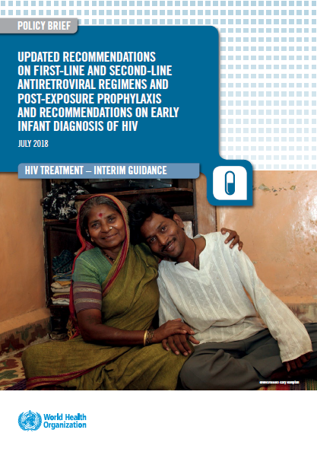
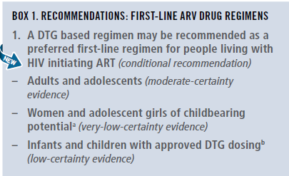
New recommendations first-line ARV regimens

Slide 9
Methods - ARV Guidelines Process
SYSTEMATIC REVIEWS
GREY LITERATURE
2016
RECOMMENDATIONS
QUALITY
OF
EVIDENCE
MODELLING
(HIV MC, IeDEA)
QUALITATIVE DATA REVIEWS
SURVEY OF ARV & LAB USE
(AMDS, GAM)
VALUES
&
PREFERENCES
FEASIBILITY
&
COST
DRUG COSTING
(GPRM, AMDS)
COMMUNITY & HCW SURVEYS & CONSULTATIONS
PROGRAMME MANAGERS SURVEY
Notes:
The key elements of the WHO guidelines development process and in particular the development of recommendations involves a synthesis from three key areas the formal assessment of evidence and ranking of its quality based on systematic reviews; an assessment of feasibility and cost with modelling and costing models, and preferences and values from community or health care workers perspective
ADD in EXISTING GUIDELINES

Slide 10
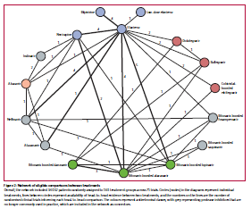
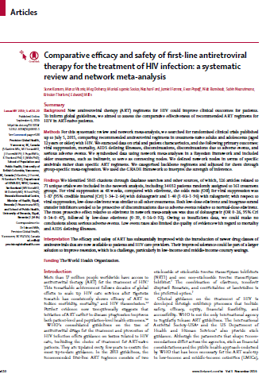
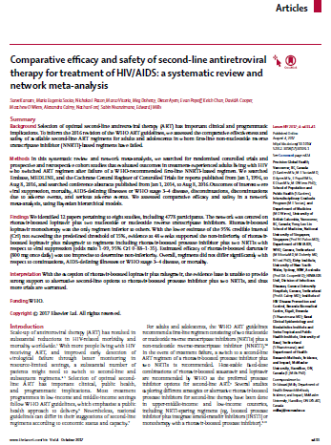
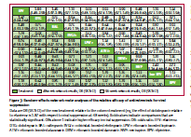
Updated NMA for first- and second-line ARV regimens from 2016 Guidelines

Slide 11
Safety and Efficacy of DTG and EFV600 in 1st line ART
(summary 2018 WHO Sys Review & NMA)
major outcomes | DTG vs EFV₆₀₀ | _{QUALITY OF EVIDENCE}
Viral suppression (96 weeks) | DTG better | moderate
Treatment discontinuation | DTG better | high
CD4 recovery (96 weeks) | DTG better | moderate
Mortality | comparable | low
AIDS progression | comparable | low
SAE | comparable | low
Reference: Steve Kanters, For WHO ARV GDG, 16-18 May 2018
WHO, 2018
Notes:
Evidence: The NMA showed that DTG, was superior to EFV in terms of viral suppression, CD4 recovery and treatment discontinuation. EFV400 was better than EFV 600 in terms of CD4 recovery and treatment discontinuation, but comparable in terms of viral supression. DTG was betetr than EFV400 in terms of viral suppression and treatment discontinuation. All regimens were comparable in terms of mortality, disease progression and occurrence of SAE. The quality for this evidence was rated according GRADE methodology.
Research gaps: There are concerns on NTD potential risk with DTG if used in the early pregnancy and during the preconception period.

Slide 12
DTG 50 mg BID with rifampicin resulted in DTG concentrations similar to DTG 50 mg QD
DTG 50 mg QD
DTG 50 mg BID
DTG 50 mg BID + rifampicin 600 mg QD
7
6
5
4
DTG concentration (µg/mL)
n=11
3
2
1
0
0 4 8 12 16 20 24
Time (hours)
There were no discontinuations from AEs and no Grade ≥3 clinical or laboratory events
*For BID dosing, simulations of the concentrations
after a second dose are provided (dashed lines in figure)
Dooley KE et al. J Acquir Immune Defic Syndr 2013;62:21−27

Slide 13
Risk and Benefits
Available clinical evidence as well as assessment of the risk and benefits support the use of DTG as a preferred 3rd agent in all lines of antiretroviral treatment and post-exposure prophylaxis in adults and adolescents, including women and adolescents girls using consistent and reliable contraception.
Concerns around the safety of DTG use during periconception period were acknowledged resulting in specific qualifications on the use of DTG in women and adolescents girls of childbearing potential

Slide 14

WHO 2018 recommendations for first-line
Population | Preferred | Alternatives | Special situations
Adult men and adolescent boys | TLDª | TLE600 TLE400 | AZT+3TC+ EFV600^{b} TDF+3TC (or FTC)+PI/r^{c}
Pregnant (from eight weeks after conception) and breastfeeding women and adolescent girls
Women and adolescent girls with effective contraception or not of childbearing potential
Women and adolescent girls of childbearing potential who want to become pregnant and have no effective contraception | TLE600 | TLE400 TDF+3TC (or FTC)+PI/r^{c} | AZT+3TC+ EFV600^{b} TDF+3TC (or FTC)+ RAL
In PLHIV with TB using rifampicin, the dose of DTG needs to be increased to 50 mg twice daily.
NVP may be used in special circumstances where alternative options are not available.
If national prevalence of EFV pretreatment drug resistance exceeds 10% or if no other alternatives are available.
TLD = TDF + 3TC + DTG
TLE = TDF + 3TC (or FTC) + EFV
Notes:
TDF & XTC are currently recommended as the preferred NRTI backbone for ART initiation
Large clinical evidence and programmatic advantages support the use of DTG as preferred 1st line option for all adults and adolescents with HIV , including women and adolescents girls using consistent and reliable contraception.
Concerns regarding safety of DTG use during periconception period were recently identified, but are based on limited data and has been closely investigated by WHO and other partners.

Slide 15
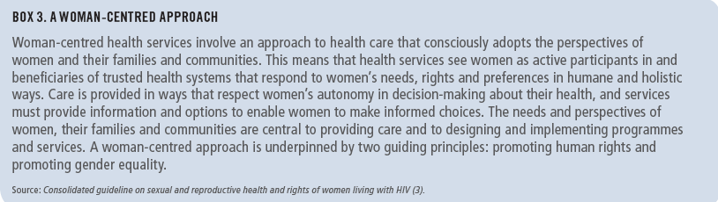
Note of caution for using DTG in women and adolescent girls of childbearing potential
Exposure to DTG at the time of conception may be associated with NTD risk among infants.
DTG appears to be safe when started after the period of risk of neural tube defects (ie, up to 8 weeks after conception).
Adolescent girls and women of childbearing potential who do not currently want to become pregnant can receive DTG together with consistent contraception (hormonal contraception and DTG have no reported or expected drug–drug interactions).
An EFV-based regimen is a safe and effective first-line regimen and can be used among women of childbearing potential during the period of potential risk for developing NTDs.
National programmes should consider the balance of benefits and risks when selecting the optimal ARV regimen for women and adolescent girls of childbearing potential (fertility levels, contraceptive availability and coverage, pretreatment resistance to NNRTIs at the population level, drug availability and the maternal and infant toxicity profile).

Slide 16
Community Engagement Timeline
2018-2019
2018
April
May
June
July
August
September
October
November
December
2019
January
February
March
April
May
18 May WHO DTG safety alert
AIDS 2018 4 dialogue events
V&P Survey
30 April-10 May
(5 lang;N=476)
V&P Repeat survey
2 July – 15 July
Community engagement at global and country levels TBD
GDG Meeting 16-18 May
3 PLHIV in GDG one female
GDG Meeting TBD
Community WebEx and outreach
Re-review of guidance
Interim guidance

Slide 17
Should a DTG-containing ART regimen be recommended as preferred first-line for ART-naive people starting treatment? (April- May 2018)

Slide 21
Recommendations for use of hormonal contraception for women living with HIV using antiretroviral therapy (ART)
ARV Class |  | COCs |  | CICs |  | Patches & rings |  | POPs |  | POIs |  |  |  | LNG & ETG implants |  | LNG-IUD
 |  |  |  |  |  |  |  |  |  | DMPA |  | NET-EN
WHO clinical stage |  | WHO stage 1 or 2 | WHO stage 3 or 4 | WHO stage 1 or 2 | WHO stage 3 or 4 | WHO stage 1 or 2 | WHO stage 3 or 4 | WHO stage 1 or 2 | WHO stage 3 or 4 | WHO stage 1 or 2 | WHO stage 3 or 4 | WHO stage 1 or 2 | WHO stage 3 or 4 | WHO stage 1 or 2 | WHO stage 3 or 4 | WHO stage 1 or 2 | WHO stage 3 or 4
NRTI
NNRTI | EFV or NVP
 | ETR or RIL
PI
INSTI (RAL)
MEC Category 1
(no restriction)
MEC Category 2
(benefits > risks)
MEC Category 3
(risks > benefits)
GRADE assessment for quality of evidence: LOW to VERY LOW
Adapted from : Medical Eligibility Criteria for Contraceptive Use (5th edition). WHO 2015
Available from : http://www.who.int/reproductivehealth/publications/family_planning/MEC-5/en/

Slide 22
Country Challenges post Alert
Contraception:
  Definition of “consistent” or “long term” contraception
  Injectable method have not be considered long term methods in most of the countries
Pregnant women:
  Difficulty to correctly dating the pregnancy in the first trimester
  If using DTG during pregnancy and switching afterwards how to ensure that the switching happen before new pregnancy
  Most countries chose EFV for PW: what about women identified late in pregnancy when DTG could give the higher benefit?
Adolescents girls:
  Group with higher risk of low adherence and low viral suppression
  Group at higher risk of unplanned pregnancies and lower uptake of contraception

Slide 23
Approach to use of DTG across different guidelines making bodies
ART history | Clinical scenarios | DHHS | BHIVA | WHO
ART naive or on using a non-DTG containing regimen | Early pregnancy
 | Late pregnancy
 | Childbearing age potential, not using contraception
 | Childbearing age potential, using effective/consistent contraception
On DTG containing regimen | Early pregnancy
 | Late pregnancy
 | Childbearing age potential , not using contraception
 | Childbearing age potential, using contraception
* The definition of early pregnancy period varies in different guidelines. DHHS: < 8 weeks from LMP; BHIVA : 1st trimester; WHO: < up to 8 weeks from conception.
Do not initiate DTG/ switch to other effective options
Initiate /continue to DTG or switch to other effective options
initiate/ switch to DTG

Slide 24
Comparing preferred and alternative 1st line ART options in adults/adolescents with HIV
DHHS, EACS and WHO ART guidelines
GUIDELINES | NRTI BACKBONE |  |  |  | NNRTI |  |  | INSTI |  |  | PI
 | TAF/XTC | TDF/XTC | ABC/3TC | AZT/3TC | EFV | NVP | RIL | DTG* | EVG | RAL | ATV | DRV | LPV
EACS (2017)
DHHS (2018)
WHO (2018)
preferred
alternative
not recommended/use in special situations
* In childbearing age women and adolescent girls, DTG should be used with consistent and reliable contraception.

Slide 25
Comparative Safety and Efficacy of DTG and LPV/r in 2nd line ART (DAWNING Study – NMA)
MAJOR OUTCOMES | NUMBER OF STUDIES | INTERPRETATION | EFFECT |  | QUALITY OF EVIDENCE
 |  |  | Relative (95% CI) | Absolute ( 95% CI)
Emergent adverse events | 1 | DTG better | 0.63 (0.45 to 0.89) | 103 fewer per 1,000 (from 187 fewer to 25 fewer) | HIGH
Viral suppression (48 weeks) | 1 | DTG better | 2.11 (1.45 to 3.21) | 109 more per 1,000 (from 54 more to 154 more) | MODERATE
Treatment discontinuation (overall) | 1 | DTG better | 0.76 (0.44 to 1.3) | 26 fewer per 1,000 (from 45 fewer to 2 fewer) | MODERATE
Treatment related adverse events | 1 | DTG better | 0.31 (0.21 to 0.45 | 47 fewer per 1,000 (from 66 fewer to 31 fewer) | LOW
Reference: Steve Kanters, For WHO ARV GDG, 16-18 May 2018

Slide 26
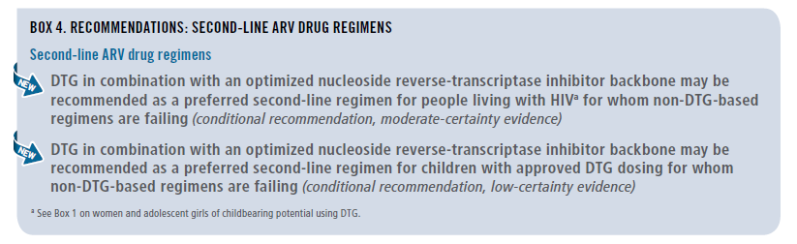
2018 WHO RECOMMENDATIONS: SECOND-LINE ARV DRUG REGIMENS

Slide 27
Preferred and alternative second-line ART regimens for adults, and adolescents (including pregnant / breastfeeding women)
Population | Failing first-line regimen | Preferred second-line regimen | Alternative second-line regimens
Adults and adolescentsª | 2 NRTIs + DTGª | 2 NRTIs^{b} + (ATV/r or LPV/r) | 2 NRTIs^{b} + DRV/r^{b,c}
 | 2 NRTIs^{b} + EFV (or NVP) | 2 NRTIs^{b} + DTG ^{a,b} | 2 NRTIs^{b} + (ATV/r or LPV/r or DRV/r^{c,d})
ª DTG can be offered to women receiving reliable contraception and who are fully informed of the benefits and risks, including the potential risk of neural tube defects (see Box 1 and the section on safety concern about DTG for women and adolescent girls of childbearing potential).
^{b} If ABC + 3TC or TDF + 3TC (or FTC) was used in the failing first-line regimen, AZT + 3TC should be used in second-line ART and vice versa.
^{c} RAL + LPV/r can be used as an alternative second-line regimen for adults and adolescents.
^{d} DRV/r can be used as an alternative PI option.

Slide 28
Sequencing options for preferred first-, second- and third-line ART regimens in adults and adolescents (including pregnant women and women childbearing potential)
Population | 1st line regimens | 2nd line regimens | 3rd line regimens
Adults and adolescents (including pregnant and childbearing age women)ª | 2 NRTIs + DTG ^{b} | 2 NRTIs + (ATV/r or LPV/r) | DRV/r ^{e f} + DTG ^{g} ± 1-2 NRTIs (where possible consider optimization using genotyping)
 | 2 NRTIs + EFV | 2 NRTIs + DTG ^{b}
 | 2 NRTIs + LPV/r | 2 NRTIs + DTG ^{c}
 | 2 NRTIs + EFV | 2 NRTIs + DTG ^{d}
a Optimized NRTI backbone should be used: AZT following TDF or ABC failure, and vice-versa.
b In childbearing age women an adolescent girls, DTG can be used in those on reliable contraception and fully informed and benefit outweighs the risk.
c This applies to children for whom approved DTG dosing is available. RAL should remain the preferred 2nd line for those children for whom approved DTG is not available.
d ATV/r or LPV/r should remain the preferred 2nd line for those children for whom approved DTG is not available. This applies to children for whom approved DTG dosing is available.
e In PI-experienced patients, the recommended DRV/r dose should be 600mg/100 mg twice daily.
f DRV/r should not be used in children younger than three years of age.
g DTG based 3rd line following use of INSTI must be administered with DTG BD.

Slide 29
Preferred and alternative second-line ART regimens for TB and HBV co-infections
Population | Preferred second-line regimen
HIV and TB coinfection | If using rifampicin in TB regimen | Optimized NRTI backbone plus double-dose DTG (that is, DTG 50 mg twice daily) or double-dose LPV/r (that is, LPV/r 800 mg/200 mg twice daily)^{acd}
 | If using rifabutin in TB regimen | Optimized NRTI backbone plus DTG or boosted PI-containing regimens at standard doses ^{ac}
HIV and HBV coinfection | AZT + TDF + 3TC (or FTC) + (DTG or ATV/r or LPV/r) ^{bd}
a If TDF + 3TC (or FTC) was used as the NRTI backbone in the 1st line failing regimen, AZT+3TC should be used in 2nd line and vice-versa.
b DRV/r can be used as an alternative PI option.
c In childbearing age women an adolescent girls, DTG can be used if she is on reliable contraception and fully informed and benefit outweighs the risk.
d Standard LPV dose with an adjusted dose of RTV (that is, LPV400mg/ RTV 400mg twice daily) can be used as alternative options.

Slide 30
Use of optimized NRTI backbone in second-line ART:
HIV drug resistance considerations
TDF/3TC+NNRTI
Switch to 2nd line with optimized NRTI backbone
(AZT+3TC+DTG)
VL > 1000 c/ml
  DTG monotherapy studies: increased risk of DTG resistance
  DTG + one NRTI= promising but inconclusive results if VL>1000 and NRTI DR is present
  In sub-Saharan Africa, most of TLE failures have no active NRTI
  57% people failing TLE carry TDF DR; of those, 80-100% have also 3TC DR
There is uncertainty if DTG + no active NRTI backbone is associated with emergence of resistance
Switch from TDF/XTC+EFV to AZT+3TC+DTG is associated with better efficacy (87% VLS) compared to maintaining the NRTI backbone TDF/XTC+EFV (79% VLS)
Gupta, Lancet ID, 2016; Steegen; JAC, 2017; DAWNING study, CROI 2018; DOMONO study, LHIV 2017, Blanco J et al CROI 2017 )

Slide 31
 | LPV/r | ATV/r | RAL | DRV/r | DTG | EFV
Completion | 65.8 | 63.3 | 75.1 | 93.3 | 89.6 | 12.2
Stop/switch | 5.2 | 17.0 | 2.7 | 0.9 | 1.4 | 87.8
Single dosing | Yes | Yes | Yes | No | Yes | Yes
Heat stable | Yes | Yes | Yes | No | Yes | Yes
Accessibility | High | Moderate | Low | Moderate | Moderate | High
Provider acceptability | High | High | High | High | High | Low
Background drug resistance | Low | Low | Low | Low | Low | Moderate
Prequalified generic | Yes | Yes | No | Yes | Yes | Yes
Cost | Moderate 220 | Moderate 205 | High 667 | Moderate 518 | Low 45 | Low 20

Slide 32
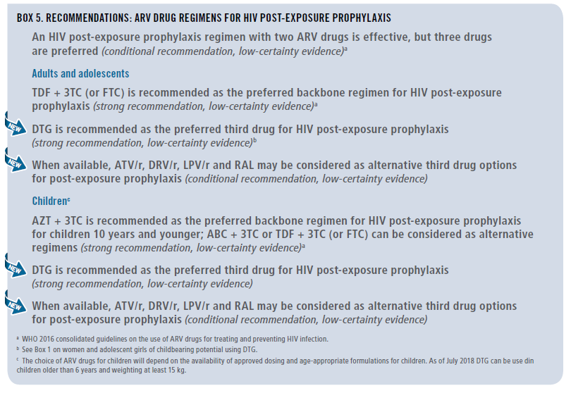
PEP recommendation

Slide 33
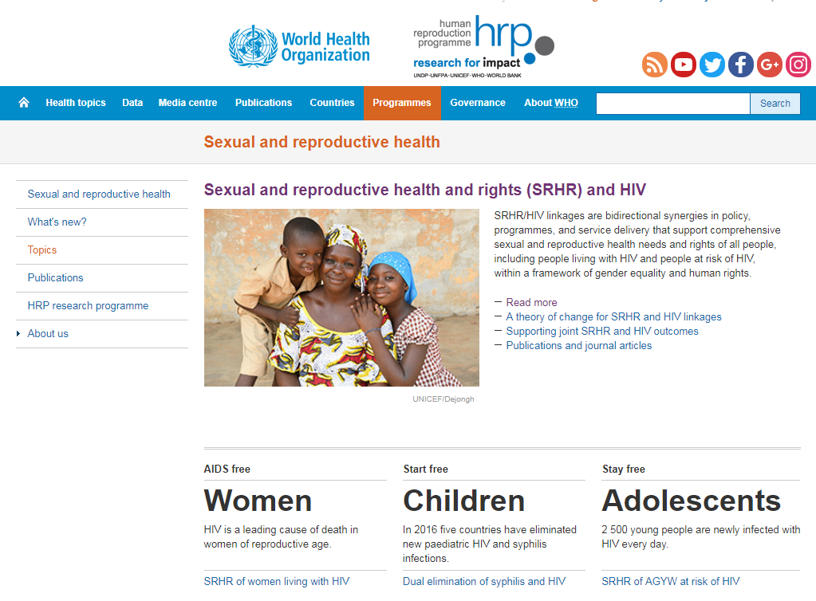
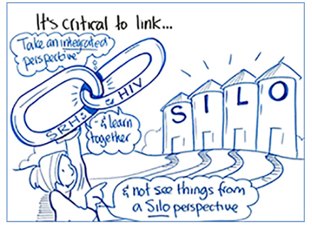
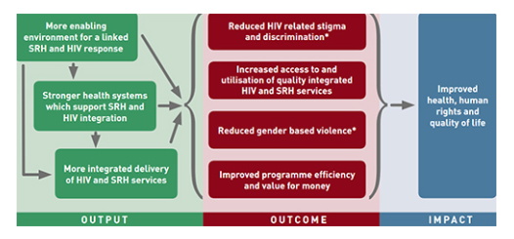
Programmes should strengthen the integration of sexual and reproductive health services within HIV treatment programmes to ensure reliable and consistent access to contraception for women and adolescent girls living with HIV.

Slide 34
Conclusions
Faced with an unexpected signal of risk in a high value and much anticipated ARV
WHO along with other regulatory issued drug safety warnings
DTG can be used and WHO emphasizes that women and adolescents of child bearing potential will need informed choices; and use DTG with consistent and reliable contraception
Communities need to be at the table to discuss policy translation at country level
Silver lining is an opportunity for integration and real linkages between HIV and SHR; FP choices need to be available in HIV clinics (and vice -versa)

Slide 35
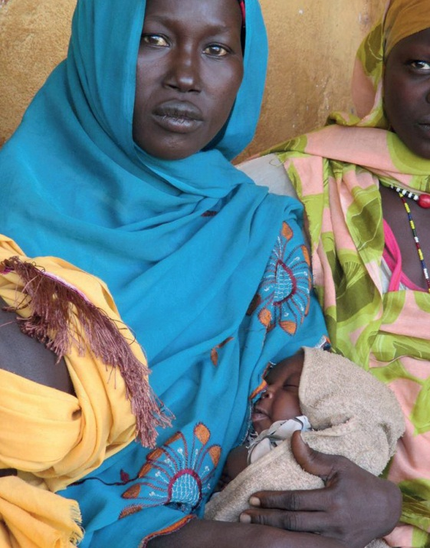
Acknowledgements
Guidelines Development Group members
Lynne Mofenson
Rebecca Zash
WHO Treatment and Care team
Marco Vitoria
Martina Penazzato
Serena Brusamento
Chantal Migone
Nathan Ford
Lara Vojnov
Silvia Bertagnolio
Vindi Singh
Ajay Rangaraj
Anisa Ghadrshenasa
Systematic Review Teams
External Review Group
PEPFAR, Global Fund, Gates, CDC, USAID
ICW, GPN+, APN+, ITPC

Slide 36
EXTRA SLIDES

Slide 37
Important drug-drug interactions with DTG
Key drug interaction | Suggested management
Amiodaquine | Use an alternative antimalarial agent
Carbamazepine , Phenytoin, and Phenobarbital | Use an alternative anticonvulsant agent (eg: valproic acid, gabapentin)
Dofetilide | Use an alternative antiarrhythmic agent
Metformin | Limit daily dose of metformin to 1000mg when used with DTG & monitor glycemic control
Polyvalent cation products containing Al, Ca, Fe, Mg and Zn (eg: antacids, multivitamins & supplements) | Use 2 hours before or 6 hours after DTG
Rifampicin | Use DTG twice daily (or substitute with rifabutin)

Slide 38
Safety and Efficacy of DTG and EFV in 1st line ART
(summary 2018 WHO Sys Review & NMA)
major outcomes | DTG vs EFV₆₀₀ | _{QUALITY OF EVIDENCE} | DTG vs EFV₄₀₀ | _{QUALITY OF EVIDENCE}
Viral suppression | DTG better | moderate | DTG better | moderate
Treatment discontinuation | DTG better | high | DTG better | moderate
CD4 recovery | DTG better | moderate | comparable | low
Mortality | comparable | low | comparable | very low
AIDS progression | comparable | low | comparable | very low
SAE | comparable | low | comparable | very low
WHO, 2018
Notes:
Evidence: The NMA showed that DTG, was superior to EFV in terms of viral suppression, CD4 recovery and treatment discontinuation. EFV400 was better than EFV 600 in terms of CD4 recovery and treatment discontinuation, but comparable in terms of viral supression. DTG was betetr than EFV400 in terms of viral suppression and treatment discontinuation. All regimens were comparable in terms of mortality, disease progression and occurrence of SAE. The quality for this evidence was rated according GRADE methodology.
Research gaps: There are concerns on NTD potential risk with DTG if used in the early pregnancy and during the preconception period.

Slide 39
Substitutions of TDF/XTC+EFV (TLE) with TDF/3TC+DTG (TLD) in patients without VL test
Switch to 2nd line with optimized NRTI backbone (AZT+3TC+DTG)
TDF/3TC +NNRTI
VL > 1000 c/ml
VL ???
Substitution to TLD based on VL test results is encouraged and considered good practice
Pros: Clinical and programmatic benefits associated with TLD
Cons:
Uncertainty in acceptability/adherence if substituting regimens in stable patients
Use of DTG with inactive NRTI backbone may be associated with increased risk of DTG DR and its transmission, affecting future use in the population.
  Population at risk estimated at 5% (= people failing first-line, carrying DR to both NRTI and without access to VL test)
Conclusion: substitution to TLD based on VL test results is encouraged and considered good practice; for programs switching to DTG in absence of VL, closely monitoring of ART outcomes (viral load levels and drug resistance) using standardized methods is recommended

Slide 40
You are taking ART that includes EFV. You have side effects that you can live with but prefer to avoid. Your healthcare worker explains that they want to keep your ART as a fixed dose combination that contains EFV. The reason for this is that in the country where you live, the MoH has made a temporary decision that women and girls with childbearing potential should avoid DTG to the potential risk of birth defects. Other people are being switched to ART that contains DTG because it is considered to be an effective drug, has fewer side effects, is cheaper for the country to provide, and over time HIV is less likely to become resistant to it. How would you feel?

